Slide 1

UNIVERSITY OF TEXAS AT DALLAS
COMPUTER ARCHITECTURE (CE6304.001)
Project Done on: BRANCH PREDICTION USING GEM5
Team Members:
Abhishek Mahesh Kumar AXM200255
Gokul Sai Raghunath GXR200021

Slide 2
OBJECTIVE:
The aim of this project is to study the effect of varying Branch Prediction parameters on different Benchmarks using GEM5 for 3 types of branch predictors.

Slide 3
BRANCH PREDICTOR
Branch predictor is a digital circuit that tries to guess which way a branch will go before this is known definitively.
The main purpose of the branch predictor is to improve the flow in the instruction pipeline.

Slide 4
TYPES OF BRANCH PREDICTORS:
The three types of Branch Predictors are:
1. Local Predictor
2. BiMode Predictor
3. Tournament Predictor

Slide 5
LOCAL PREDICTOR
The 2-bit scheme is a specialization of a more general scheme which has an n-bit saturating counter for each entry in the prediction buffer.
It works better if the branches move in the same direction.

Slide 6
TOURNAMENT PREDICTOR
Tournament prediction strategies use a combination of two or more other prediction strategies, usually it uses one from Global prediction and the other from local prediction.
It has ability to choose correct predictor for a given branch.

Slide 7
BIMODE PREDICTOR
They can deliver accurate branch prediction without changes to the instruction set architecture or pre-existing binaries.
It is shown to preserve the merits of global history-based prediction while reducing destructive aliasing and as a result improving the prediction accuracy.

Slide 8
PART 1
SETTING UP THE GEM5

Slide 9
ACCESSING GEM5
A virtual server has been used under UTD VPN.
Putty server was used with the host name as “ce6304.utdallas.edu” which has a connection type of SSH.
We can access the directory by providing our UTD login details(NetID – AXM200255).
The gem5 simulator is found in /usr/local/gem5
After copying the GEM5 directory to our directory, we can build the scons with the following command:
scons build/X86.gem5.opt

Slide 10
BENCHMARK
Benchmarks can be downloaded from the following directory:
https://github.com/timberjack/Project1_SPEC.git
There are five Benchmarks, namely :
401.bzip2
429.mcf
456.hmmer
458.sjeng
470.lbm
(We have used 458.sjeng and 470.lbm benchmarks)

Slide 11
CHALLENGES
Installation of the software GEM5 was easy, but installing the dependencies were difficult since the commands and resources provided weren’t functional.
Automation of all the processes proved to be challenging, hence we did it manually, which consumed a lot of time and had less data.

Slide 12
PART 2
ADDING BRANCH PREDICTOR SUPPORT TO TIMING SIMPLE CPU

Slide 13
ADDING BRANCH PREDICTOR SUPPORT TO TIMING SIMPLE CPU
GEM5 software does not contain Branch Predictor Support. The following steps are used to add branch predictor support:
Access the location: /home/eng/g/axm200255/CA_Proj/gem5/gem5/src/cpu/simple
Access the file: BaseSimpleCPU.py
First delete all the files in $gem5/build/X86 and then use the “scons” command to recompile the processor in order to have the necessary chances without any error.

Slide 14
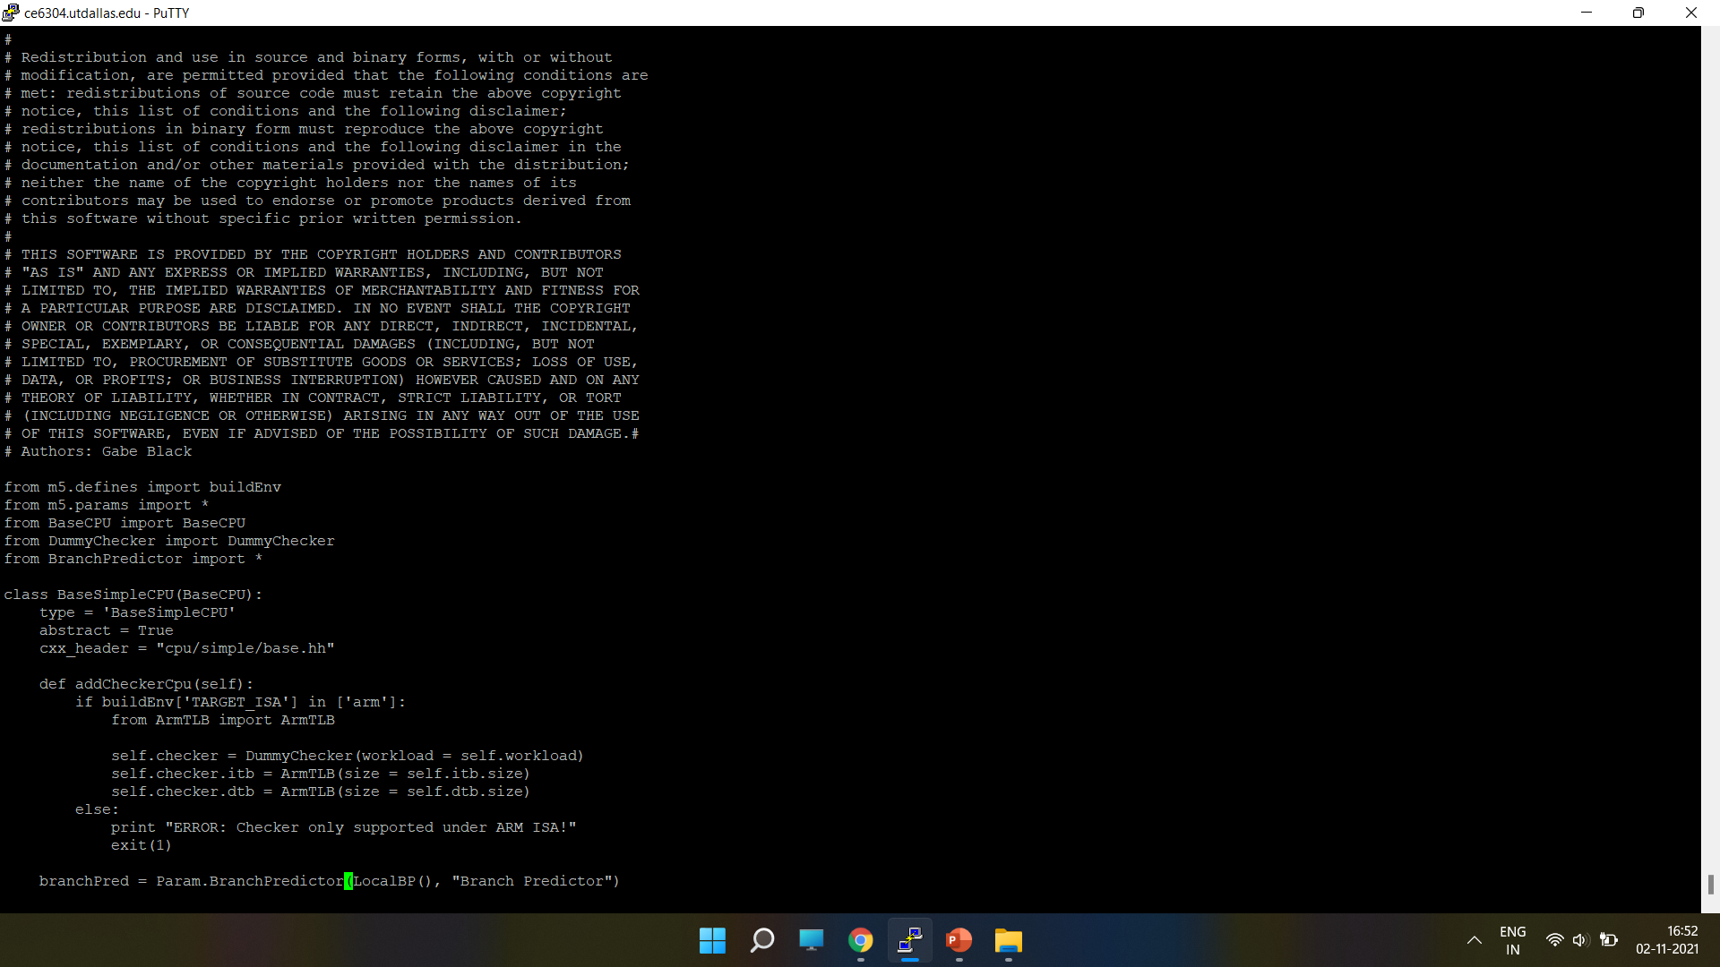

Slide 15


Slide 16


Slide 17
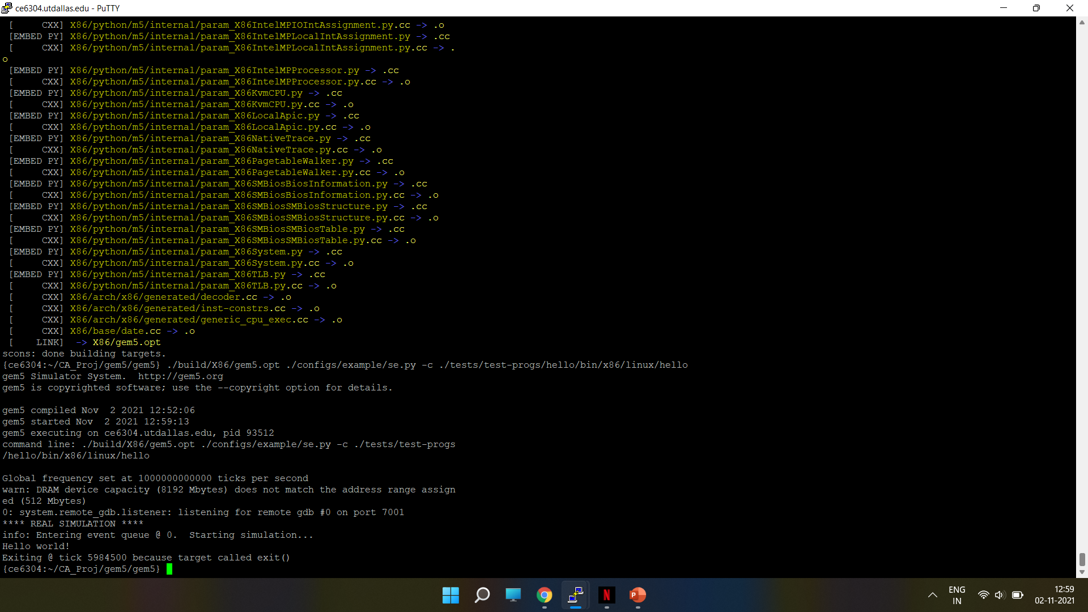
“HELLO WORLD” test program by using the following command line: ./build/X86/gem5.opt ./configs/example/se.py -c ./tests/test-progs/hello/bin/x86/linux/hello

Slide 18
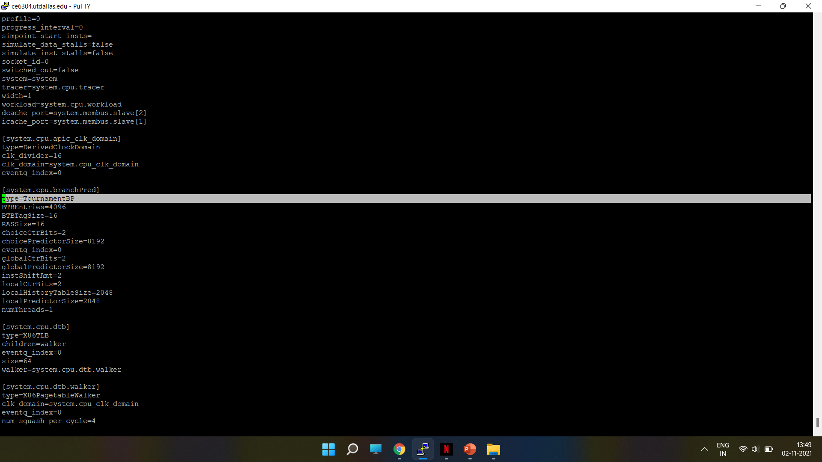
RESULT OF LOCALBP IN CONFIG.INI FILE The below Screenshot shows the TournamentBP type of Branch Predictor in the config.ini file after running HelloWorld test program.

Slide 19
PART 3
ADDING PARAMETER IN THE STATS.TXT FILE (OUTPUT FILE)

Slide 20
ADDING PARAMETER IN THE STATS.TXT FILE (OUTPUT FILE)
The following additional parameters should be added to the gem5 source file:
1. BTBMissPct is defined as:
BTBMissPct = (1 - (BTBHits/BTBLookups)) * 100
where:
BTBHits is “Total number of BTB Hits”
BTBLookups is “Total number of BTB References”
2. BranchMispredPercent is defined as:
BranchMispredPercent = (numBranchMispred / numBranches) * 100;
where:
numBranchMispred is “Total number of miss-predicted Branches”
numBranches is “Total number of Branches fetched”

Slide 21
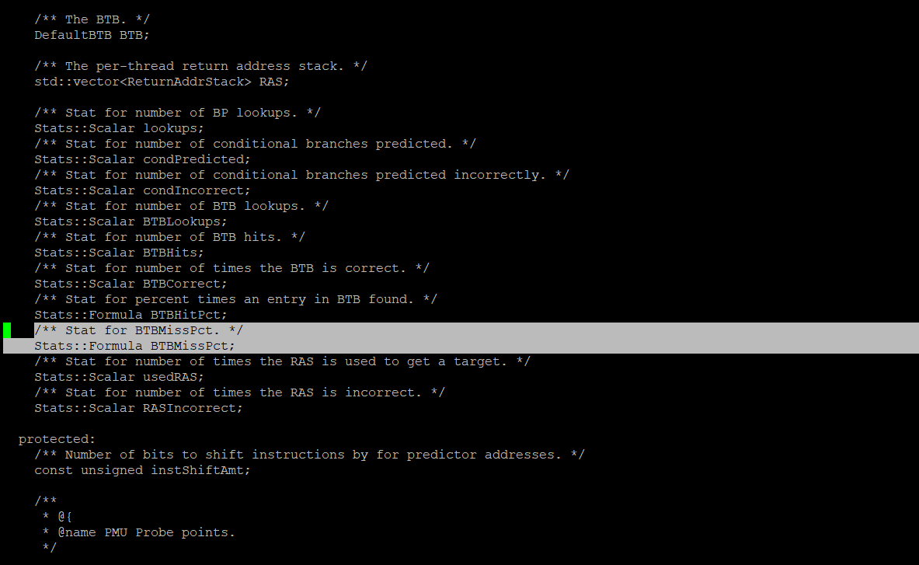
BTB MISS PERCENTAGE - HEADER FILE EDIT
To add BTBMissPct in the stats.txt file, the header file bpred_unit.hh is edited
This file can be found in the path : gem5/src/cpu/pred/

Slide 22
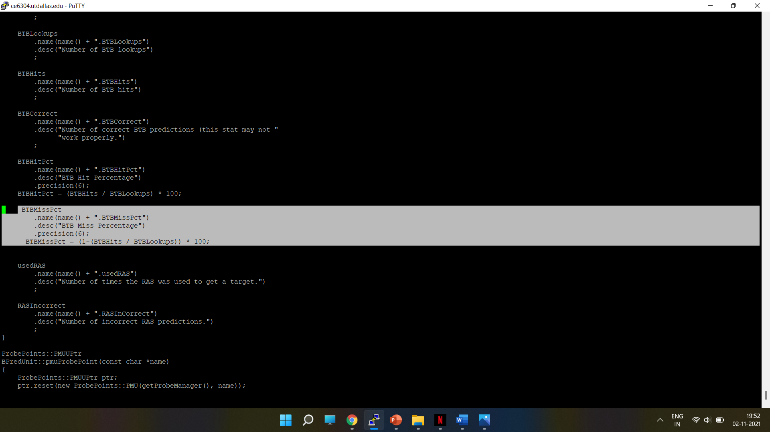
CALCULATING BTB MISS PERCENTAGE – SOURCE FILE EDIT
To calculate the value of BTBMissPct and display it in the stats.txt file, the source file bpred_unit.cc is edited.
This file can be found in the Path : gem5/src/cpu/pred/

Slide 23
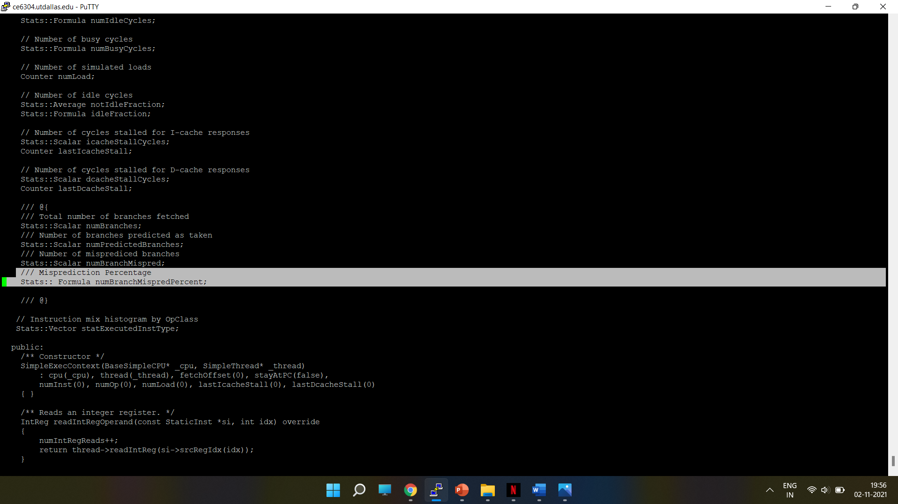
BRANCH MISPREDICTION PERCENTAGE - HEADER FILE EDIT
To add Branch misprediction percentage in the stats.txt file, the header file exec_context.hh is edited.
This file can be found in the path : gem5/src/cpu/simple/

Slide 24
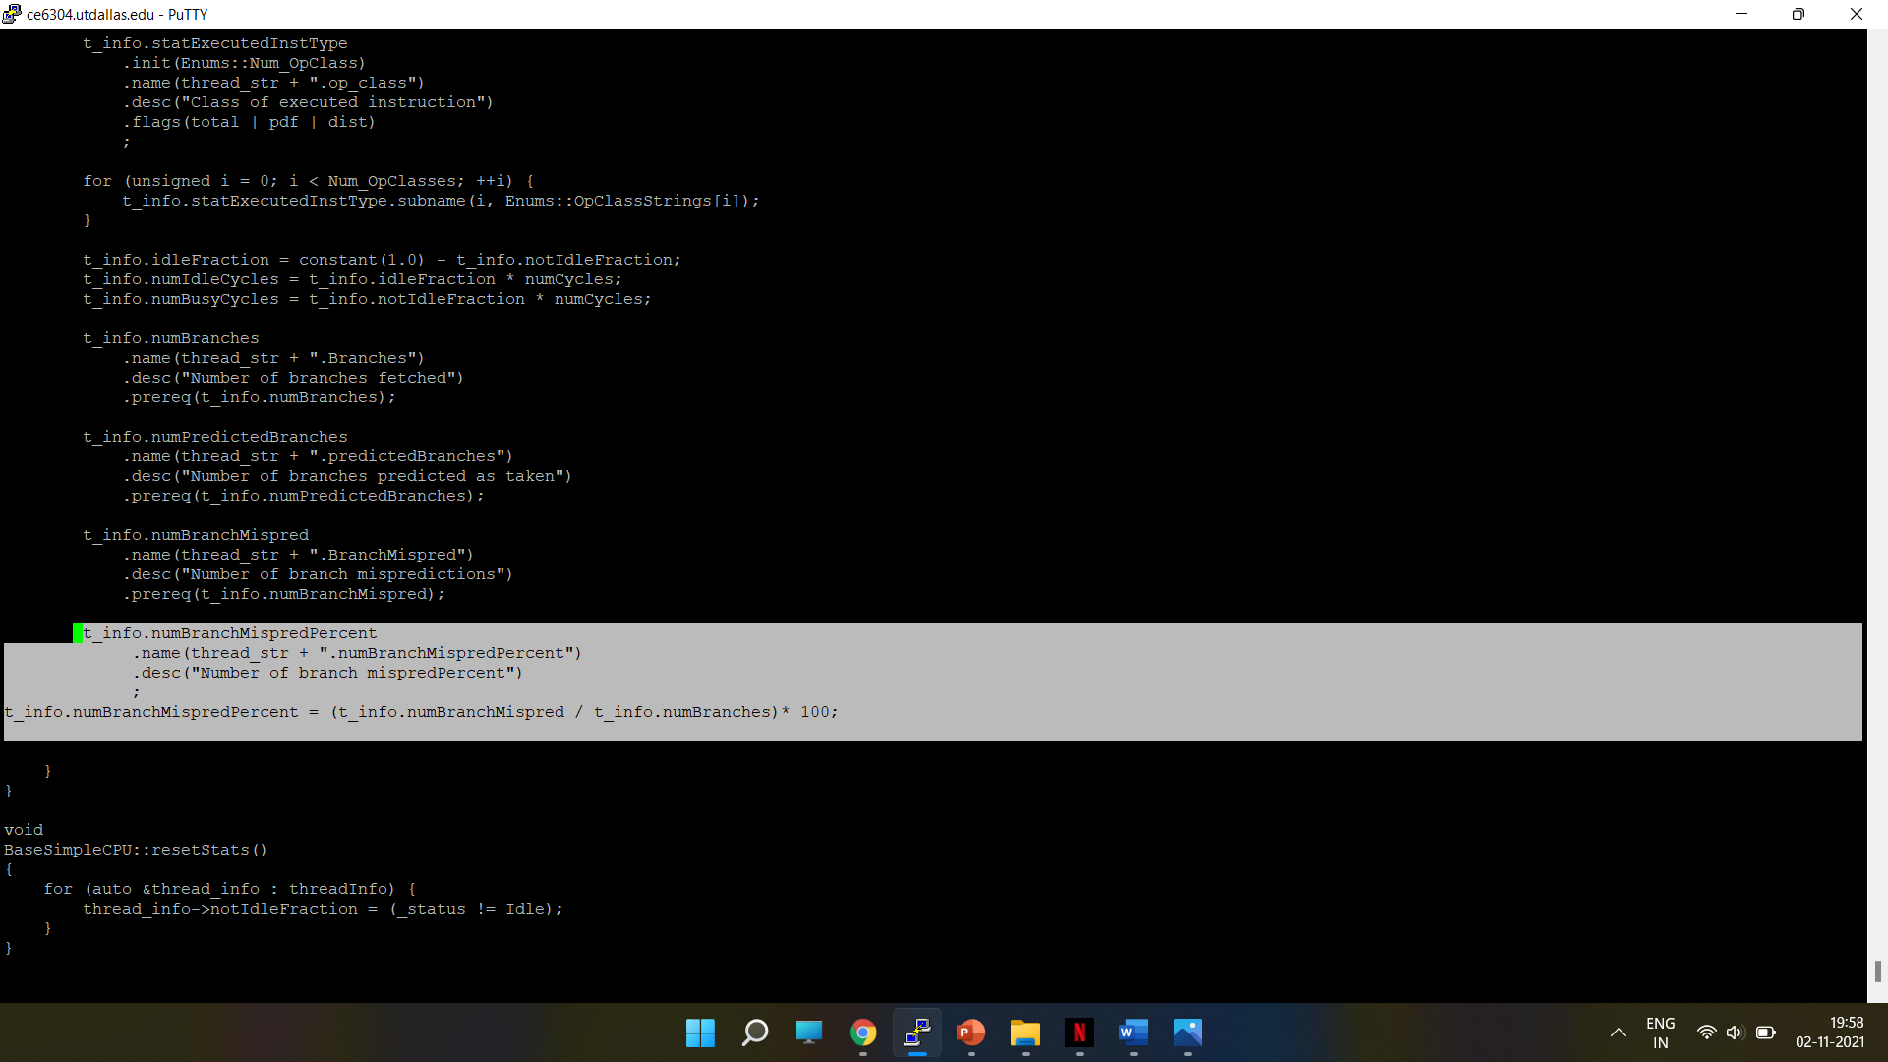
BRANCH MISPREDICTION PERCENTAGE - SOURCE FILE EDIT
To calculate the value, the formula for Branch misprediction percentage in source file base.cc is added.
This file can be found in the path : gem5/src/cpu/simple/

Slide 25
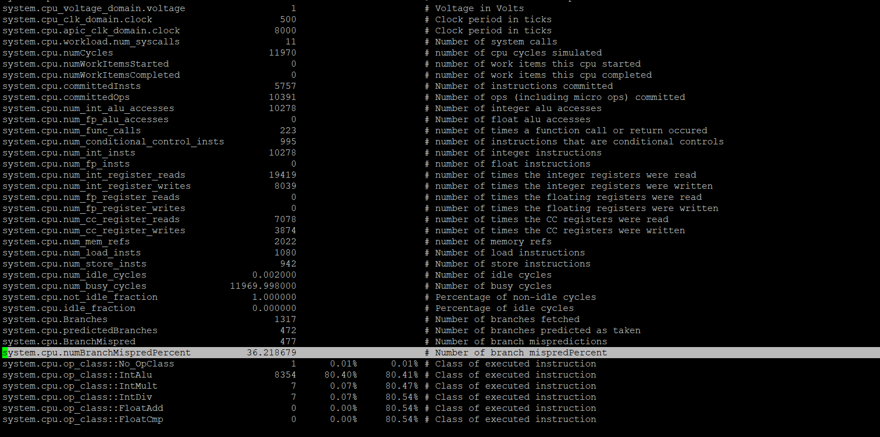
RESULT IN STATS.TXT FILE
The results in stats.txt file of TournamentBP() branch predictor with the applied changes to the source and header files is shown below:

Slide 26
PART 4:
RUNNING THE BENCHMARKS WITH THE CHANGES AND COMPARING THE DIFFERENT BRANCH PREDICTORS

Slide 27
BRANCHPREDICTOR.PY FILE CONFIGURATION
They can be found from the Path : gem5/src/cpu/pred/BranchPredictor.py
Attribute | LocalBP() | TournamentBP() | BiModeBP()
BTBEntries | 2048 | 2048 | 2048
Local predictor size | 1024 | 1024 | -
Global predictor size | - | 4096 | 2048
Choice predictor size | - | 4096 | 2048

Slide 28
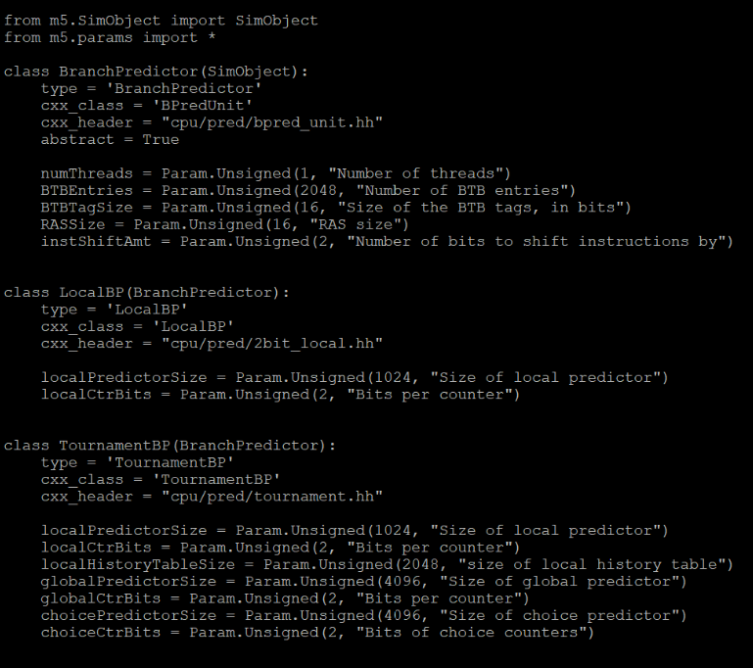
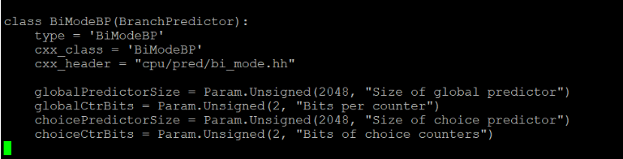

Slide 29
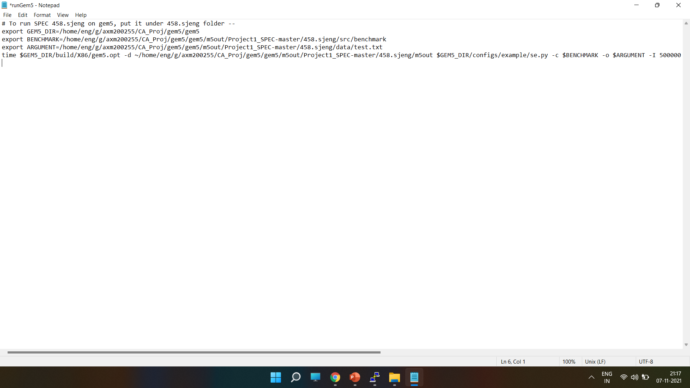
Benchmark : 458.sjeng
The screenshot shows the edited version of runGem5.sh file for 458.sjeng

Slide 30
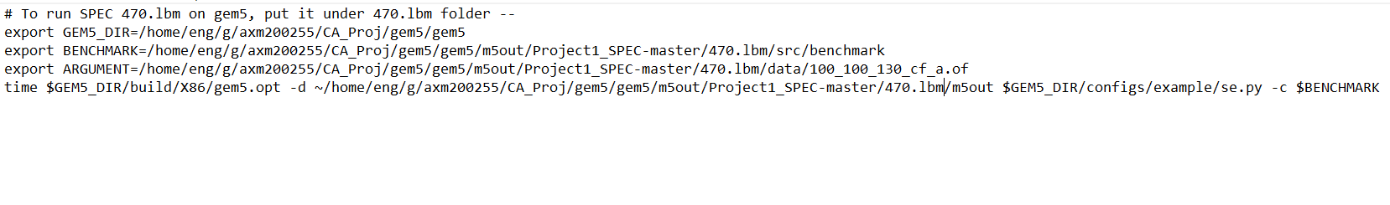
Benchmark : 470.lbm
The screenshot shows the edited version of runGem5.sh file for 470.lbm

Slide 31
BRANCH PREDICTOR EXPLORATION
Branch Predictor is explored for each case ( Local, BiMode and Tournament) by changing one parameter at a time while other parameters are constant i.e., varying the local predictor size and global predictor size results in varying their BranchMisprediction and BTBMissPct values will be changed.

Slide 32
LocalBP
BTB ENTRIES | LOCAL BP | BTB MISS % | BRANCH MISPRED %
2048 | 1024 | 9.068 | 14.40
2048 | 2048 | 3.35 | 5.23

Slide 33
Tournament BP
BTB ENTRIES | LOCAL | BTB MISS % | BRANCH MISPRED %
2048 | 1024 | 4.77 | 9.78
2048 | 2048 | 1.92 | 3.75

Slide 34
Tournament BP
BTB ENTRIES | GLOBAL | BTB MISS % | BRANCH MISPRED %
2048 | 4096 | 4.8 | 9.86
2048 | 8192 | 1.95 | 3.72

Slide 35
Tournament BP
BTB ENTRIES | CHOICE | BTB MISS % | BRANCH MISPRED %
2048 | 4096 | 4.8 | 9.86
2048 | 8192 | 1.95 | 3.72

Slide 36
BiMode BP
BTB ENTRIES | GLOBAL | BTB MISS % | BRANCH MISPRED %
2048 | 2048 | 7.09 | 10.21
2048 | 4096 | 1.86 | 3.84

Slide 37
BiMode BP
BTB ENTRIES | CHOICE | BTB MISS % | BRANCH MISPRED %
2048 | 2048 | 7.09 | 10.21
2048 | 4096 | 1.48 | 3.72

Slide 38
BP EXPLORATION CONCLUSION:
By changing the sizes of the localBP and local, global and choice predictor sizes for the tournament predictor and global and choice for BiModeBP it is observed that when the global predictor size is high the BranchMisprediction Percent is found to be low.
Hence, as we increase BTBEntries for each Branch predictor, we can observe that both BTBMissPct and BranchMispredPct are decreased.

Slide 39
CONCLUSION:
On observation, we can conclude that TournamentBP() will have lowest possible value of BTBMissPct and BranchMispredPct for both 458.sjeng benchmark.

